Slide 1
EE4007 - OPTICAL ELECTRONICS
January 2010
© Alan P. Morrison
Lecture 1 - Optical Communications Systems

Slide 2
INTRODUCTION TO OPTICAL COMMUNICATIONS
January 2010
Origins: signal fires, smoke signals, signal lamps and flares on ships
1880 – Alexander Graham Bell
  Photophone
  Intensity modulated sunlight over 10s of metres
1880 – 1960 Low capacity short range free space links
© Alan P. Morrison

Slide 3
PROGRESS SINCE 1960
January 2010
Laser invented in 1960s
Low loss optical fibre in 1970s
Long life semiconductor lasers in 1980s
Practical optical amplifiers in 1990s
© Alan P. Morrison

Slide 4
USING OPTICAL COMMS
January 2010
Most common wavelengths: 850 and 1550nm
Optical fibre => extremely low loss transmission medium ~0.15dB/km
Optical amplification => in excess of Gb/s data transmission @ distances > 10⁴ km
Greater raw transport capacity compared to conventional electronic systems
© Alan P. Morrison

Slide 5
ADVANTAGES OF FIBRE OVER COPPER
Electromagnetic Interference (EMI)
  Light not susceptible => no crosstalk
  Ambient electrical noise has no effect on light propagation
Higher bandwidth – potentially 10s-100s of THz
Weight and size: e.g. 100m coaxial cable approx. 800% heavier than plastic optical fibre and approx. 700% heavier than hard-clad silica fibre
Speed – current fibre networks operate 2.5Gb/s – 10Gb/s
Security – difficult to “tap” optical fibre
Low attenuation ~ 0.15dB/km for single mode silica fibre
January 2010
© Alan P. Morrison

Slide 6
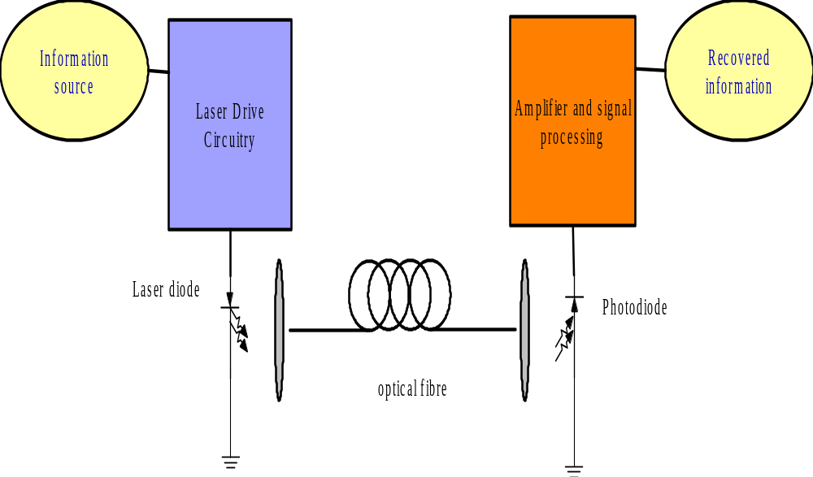
SIMPLEST POINT-POINT OPTICAL LINK
January 2010
© Alan P. Morrison

Slide 7
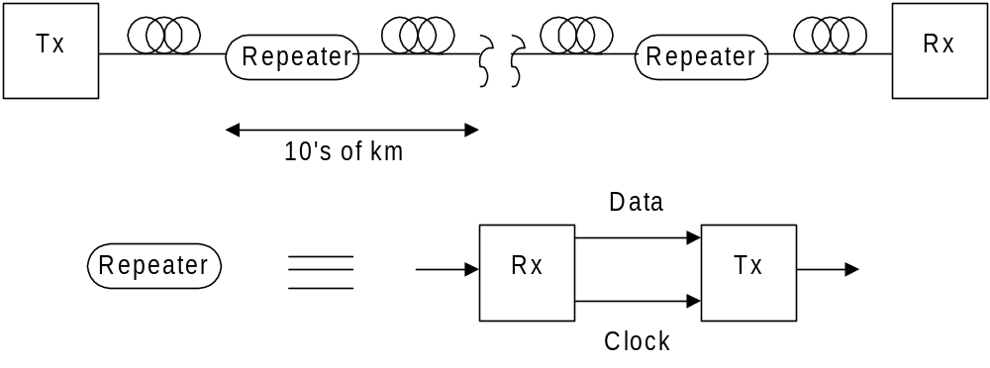
EXAMPLES OF FIBRE-BASED SYSTEMS
January 2010
1. Long haul, using repeaters.
© Alan P. Morrison
Repeater => electrical regeneration

Slide 8
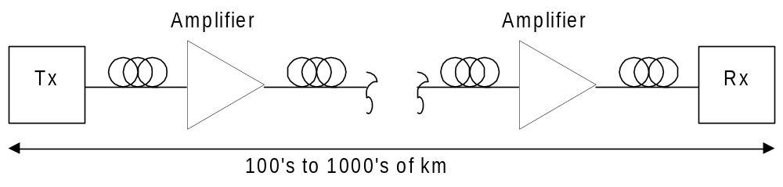
EXAMPLES OF FIBRE-BASED SYSTEMS
January 2010
2. Repeaterless long-haul
© Alan P. Morrison
Amplifier is Erbium-doped fibre amplifier (EDFA) or
Semiconductor Optical Amplifier (SOA)

Slide 9
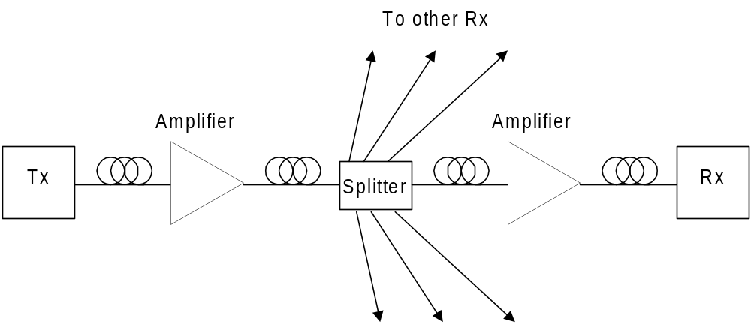
EXAMPLES OF FIBRE-BASED SYSTEMS
January 2010
3. Broadcast
© Alan P. Morrison

Slide 10
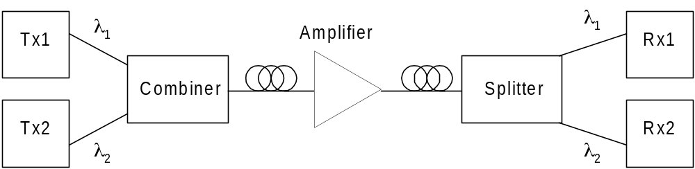
EXAMPLES OF FIBRE-BASED SYSTEMS
January 2010
4. Wavelength division MUX (WDM)
© Alan P. Morrison

Slide 11
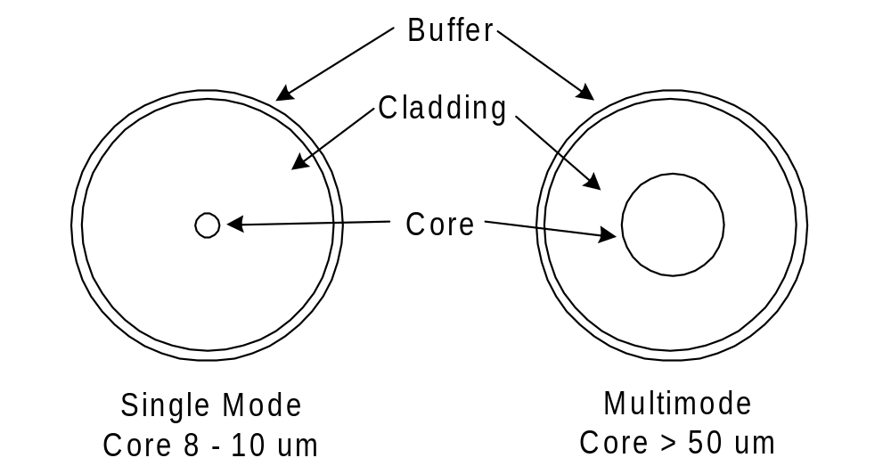
OPTICAL FIBRE
January 2010
Optical Fibre: cylindrical dielectric waveguide made from high purity materials e.g. silica glass.
Mode: particular possible solution to the electromagnetic propagation equation for the fibre.
Single mode => only one solution (spatial distribution) exists;
Multimode => several solutions co-exist and are supported.
© Alan P. Morrison

Slide 12
MODAL DISTORTION
January 2010
Various spatial distributions travel at different velocities in multimode fibre
  causes intersymbol interference
  limits usefulness of multimode fibres in high data rate systems
  single mode fibres do not suffer from this limitation
© Alan P. Morrison

Slide 13
POLARISATION
January 2010
2 orthogonal polarisation states exist for a single propagating mode (TE & TM)
  Any velocity difference between the two polarisation states leads to : polarisation mode dispersion (PMD)
  PMD is usually small, but can cause significant degradation in long-haul high bit-rate systems.
© Alan P. Morrison

Slide 14
ATTENUATION
January 2010
ATTENUATION: reduction in light power along fibre length, caused by absorption and scattering.
Rayleigh scattering proportional to ν⁴ , due to variations in density and compositional uniformity of glass in fibre.
Impurities in glass may introduce local absorption peaks e.g. water vapour or metallic ions.
See next slide for graph of absorption as a function of wavelength of light.
© Alan P. Morrison

Slide 15
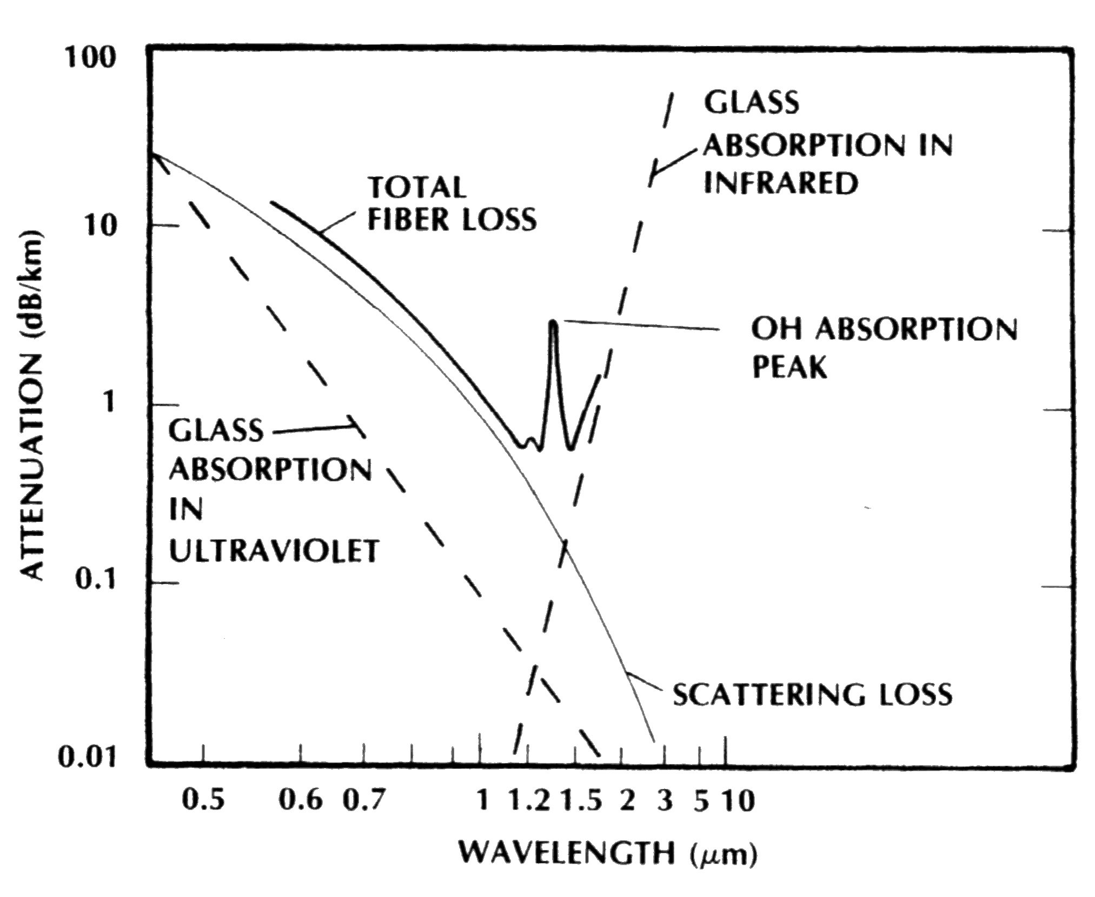
ATTENUATION VS. WAVELENGTH
January 2010
© Alan P. Morrison

Slide 16
SYSTEM PERFORMANCE
January 2010
Mainly concerned with digital communications in this course…
Information => stream of bits
Objective => minimise number of bit errors in output data
stream
Uses : telephone, computer links, back-bone data links for internet traffic etc…
Digital system is specified as a data rate and an associated probability of error, called the bit-error rate (BER)
The generic system will consist of a transmitter, a propagation medium and a receiver.
© Alan P. Morrison

Slide 17
LINK BUDGET
January 2010
System level performance can be quantified in terms of a system link budget.
All link budgets have at least 3 entries:
(i) Transmitter (Tx) ; (ii) Channel (fibre link) ; (iii) Receiver (Rx)
EXAMPLE: Elementary Link Budget
A transmitter has an average transmit power of 1mW, the channel introduces propagations losses such that only 1% of the signal reaches the end of the link. The receiver has a sensitivity of -30 dBm, what is the link margin?
© Alan P. Morrison

Slide 18
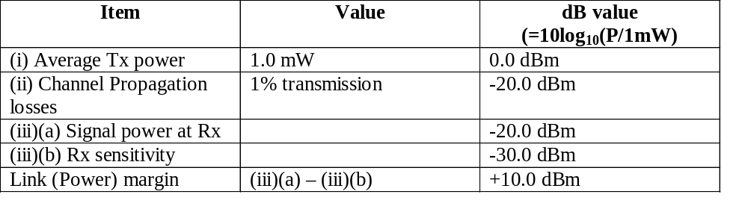
LINK BUDGET
January 2010
© Alan P. Morrison
A positive link margin is required for the system to work. If a negative link margin is obtained then the link is not good enough for desired performance.

Slide 19
LINK MARGIN
For a specified quality of service (QoS) you need a minimum signal-to-noise ratio (SNR) at the receiver.
Exact SNR required depends upon:
  receiver noise statistics
  type of modulation, detection and demodulation used
  imperfections in modulator, photodetector and demodulator
  optical non-linearities
  any error correcting codes that may be used
Once exact SNR is determined, an additional amount, called the link margin is deliberately added to account for any uncertainties.
January 2010
© Alan P. Morrison

Slide 20
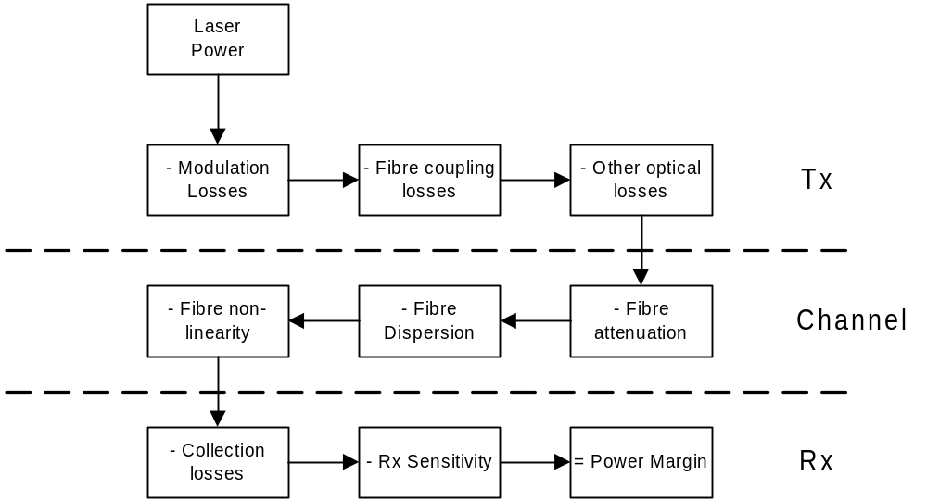
LINK BUDGET FOR FIBRE OPTIC CHANNEL
January 2010
© Alan P. Morrison

Slide 21
DETAILED EXAMPLE
Laser has 3 mW average output power. Internal optical isolator has 1.1 dB insertion loss. Coupling loss between the laser and fibre is 3.7 dB => effective Tx power O/P = 1 mW or 0 dBm. Diagram on next slide gives remaining specification.
January 2010
Receiver sensitivity is specified at a particular data rate and wavelength of operation.
Assumptions:
1. All fibre ends are terminated in low reflection loads
2. For simplicity assume fibre dispersion and non-linearity are insignificant.
© Alan P. Morrison

Slide 22
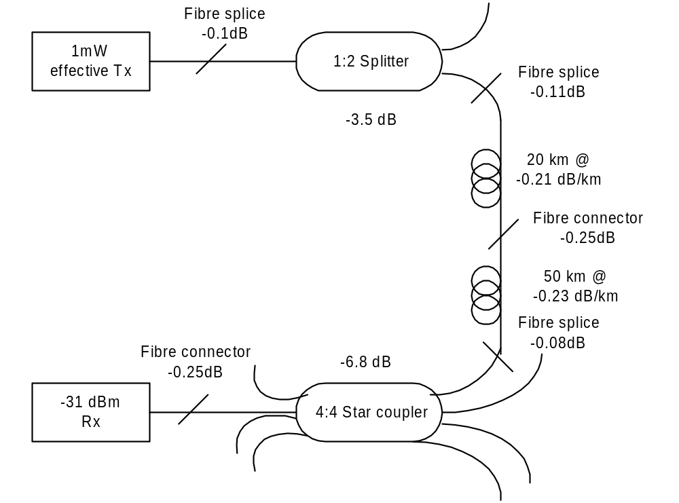
DETAILED EXAMPLE
January 2010
© Alan P. Morrison

Slide 23
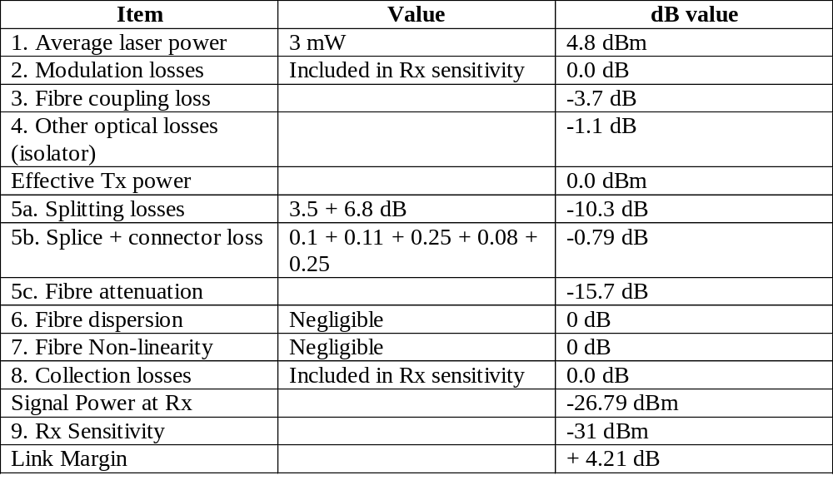
DETAILED EXAMPLE
January 2010
© Alan P. Morrison

